Slide 1
CSE 391: Programming for the Internet
M. Abdur Rahman

Slide 2
Prerequisite
Join the Piazza and buX course for updated information.
At least One Programming Language idea
Data structures
OOP
Idea Over XML
Database
Software Engineering
Software Analysis and Design

Slide 3
Acknowledgements
Software Engineering for Web Applications (MIT Open Course Ware)
COMP519: Web Programming (University of Liverpool)
  http://www.csc.liv.ac.uk/~martin/teaching/comp519/
Teach Yourself Ajax in 10 Minutes, Phil Ballard, Sams Publishing, 2006
http://www.w3schools.com

Slide 4
Web ≠ Internet
Internet : a physical network connecting millions of computers using the same protocols for sharing/transmitting information (TCP/IP)
  in reality, the Internet is a network of smaller networks
World Wide Web: a collection of interlinked multimedia documents that are stored on the Internet and accessed using a common protocol (HTTP)
Key distinction: Internet is hardware; Web is software
Many other Internet-based applications exist
e.g., email, telnet, ftp, usenet, Instant Messenger, Torrent, …

Slide 5
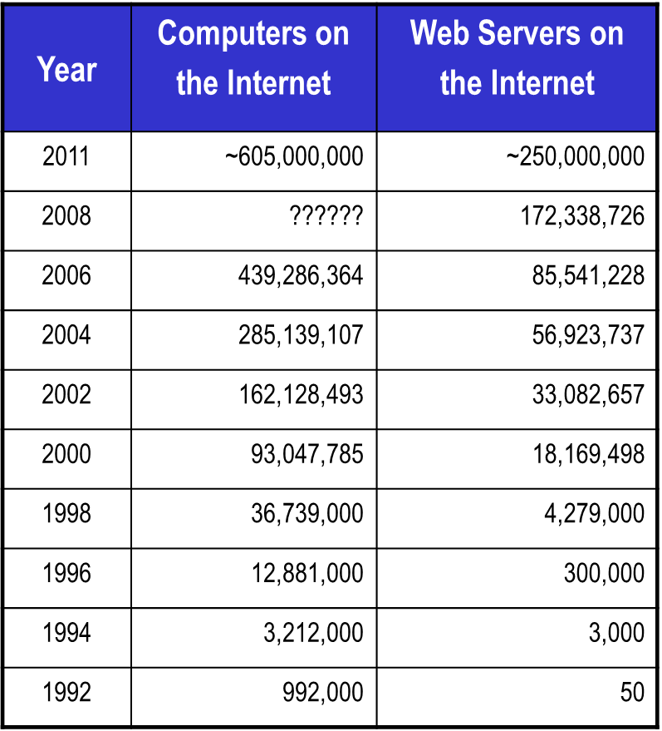
Web Growth
Stats from
Netcraft Web Server Survey.
Google Chrome
Firefox
Safari
IE, Opera
Netscape
Mosaic
A 2012 estimate suggests 30-35 billion Web pages! (Google’s estimated index size is about 30 billion webpages.) (WorldWideWebSize.com)

Slide 6
Basics: Communications Protocols
Old-Style
Program A opens a connection to Computer Program B
Both programs run continuously
This makes it easy for Program B to remember what Program A has said

Slide 7
Basics: Communications Protocols
HTTP: Stateless and Anonymous
HyperText Transfer Protocol (HTTP)
HTTP is stateless

Slide 8
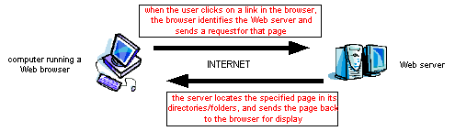
World Wide Web
the Web is the world’s largest client/server system
  communication occurs via message passing
    within browser, select URL of desired page
    browser requests page from server
    server responds with message containing
      type of page (HTML, gif, pdf, zip, …)
      page contents
    browser uses type info to correctly display page
    if page contains other items (images, applets, …),
      browser must request each separately

Slide 9
Server Growth
Feb 2020
Stats from Netcraft Web Server Survey.
https://news.netcraft.com/archives/2020/06/25/june-2020-web-server-survey.html
Developer | May 2020 | Percent | June 2020 | Percent | Change
nginx | 75,619,977 | 28.95% | 77,436,626 | 29.51% | 0.56
Apache | 72,057,359 | 27.59% | 71,514,159 | 27.25% | -0.33
Microsoft | 46,864,883 | 17.94% | 46,133,117 | 17.58% | -0.36
Google | 2,367,143 | 0.91% | 2,279,759 | 0.87% | -0.04

Slide 10
Basics: HTTP Concept
Web Page (Client)
Web Browsers
Client-Side Programming
Web Servers (Server)
Server-Side Programming

Slide 11
Basics: anatomy of a typical HTTP session
User types "www.yahoo.com" into a browser
Browser translates www.yahoo.com into an IP address and tries to open a TCP connection with port 80 of that address
Once a connection is established, the browser sends the following byte stream: "GET / HTTP/1.0".
The "GET" means that the browser is requesting a file.
The "/" is the name of the file, in this case simply the root index page.
The "HTTP/1.0" says that this browser would prefer to get a result back adhering to the HTTP 1.0 protocol.
Yahoo responds with a set of headers indicating which protocol is actually being used.
Yahoo sends the contents of its index page
The TCP connection is closed when the file has been received by the browser.

Slide 12
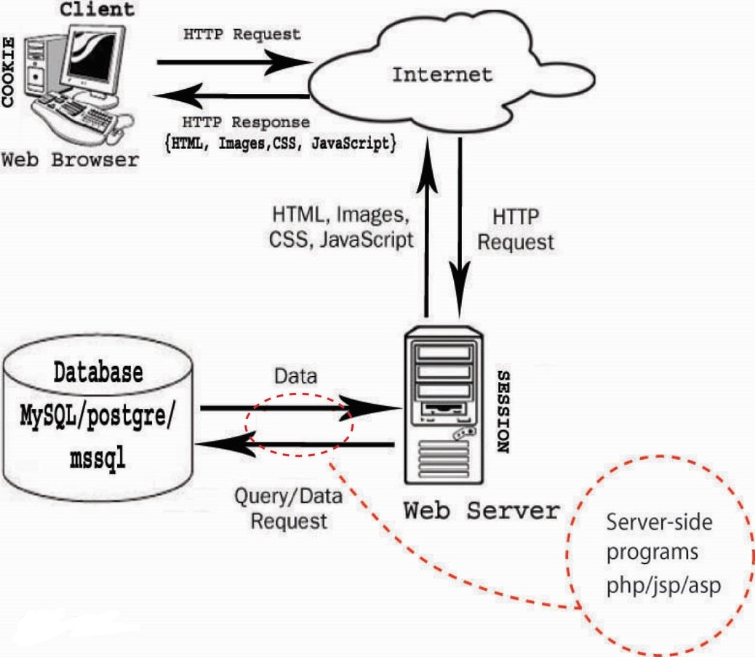
Basics: HTTP Concept

Slide 13
Basics: HTML / CSS / Jscript
Hyper Text Markup Language
View in Client Side
Cascading Style Sheets
Visual Representation property only
Some what Client Side Manipulation with JavaScript

Slide 14
Query?
Lets discuss it in online session…

